Slide 1
Deaf Heaven
JANNATUL FARDOUS UMAMA MIRZA MOHIUDDIN
ID:20-42616-1 ID:20-43598-1
ATIQUR RAHMAN AKASH SAIFUL ISLAM
ID:20-42566-1 ID:20-42585-1

Slide 2
PROJECT: COVID-19
THEME:
THERE IS CURENTLY NO VACINE AVAILABLE FOR THIS DEADLY
VIRUS CORONA. THIS PROJECT WILL HELP TO CREATE AWARNESS
AMONG THE PEOPLE.

Slide 3
WHAT IS COVID-19
IT IS A FLU VIRUS
‘CO’ STANDS FOR CORONA ‘VI’ STANDS FOR VIRUS
‘D’ STANDS FOR DISEASES.
11 FEB 2020, WHO ANNOUNCED THE NAME ‘COVID-19’
DEC 2019, FIRST COVID 19 CASE FOUND IN CHINA
7 MARCH 2020, FIRST CASE CONFIRMED IN BANGLADESH

Slide 4
HOW COVID-19 SPREAD?
Face to face contact with a confirmed case
Within 1 meter for 15 minutes
Direct physical contact with a confirmed case
Using the material of a confirmed case
Direct care of a patient with out ppp
Other situations indicate by local risk assessment

Slide 5
HOW TO PREVENT COVID-19
WASH HAND OFTEN FOR 20 SECONDS AND
ENCOURAGE OTHER TO DO THE SAME
IF NO SOUP AND Water available use
Sanitizer with at least 6o % alcohol
Cover coughs and sneezes with tissue
Avoid touching mouth ,eye and
nose with unwashed hand
Avoid close contact with sick people

Slide 6
STRATEGIC OBJECTIVES FOR COVID-19
INTERRUPY HUMAN TO HUMAN TRANSMISSION
IDENTITY,ISOLATE AND CARE FOR PATIENT EARLY
MINIMIZE SOCIAL AND ECONOMIC IMPACT
THROUGH MULTISECTORAL PARTNARSHIP
STOP TRAVALLING AND STAY HOME
TRY TO FEEL LESS ANXIOUS ABOUT OUTBREAK.

Slide 7
PROJECT DISCUSSION
LOG IN
FIRSTLY THERE IS A LOG IN SECTION. YOU HAVE TO REGISTER
FOR CONTINUING IN THE PROGRAM. YOU CAN SELECT
AMOUNG DOCTOR,PATIENT AND ADMIN FOR REGISTERING.
THEN YOU CAN LOG IN TO YOUR SELECTIVE OPTION.
THERE IS ALSO A FORGET PASSWORD OPTION.

Slide 8
DOCTOR MENU
USER CAN ADD NEW PATIENT RECORD
USER CAN SEARCH FOR A PATIENT RECORD
USER CAN SEE ALL PATIENT INFORMATION
USER CAN CHECK WEATHER HE IS AFFECTED

Slide 9
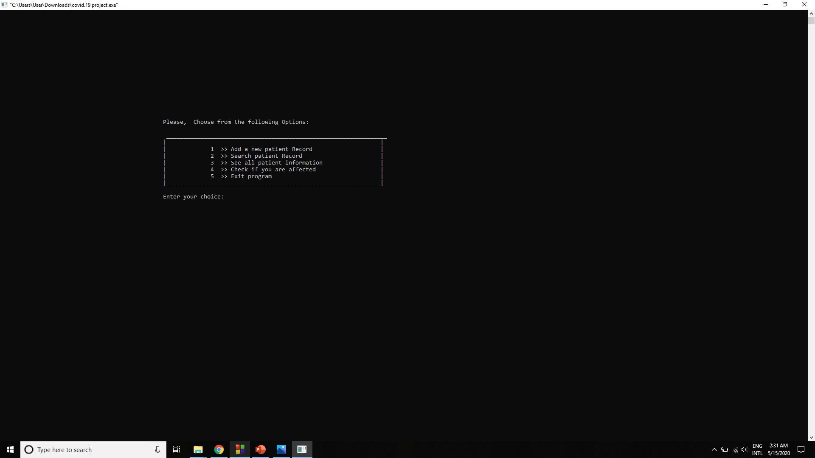
DOCTOR MENU

Slide 10
PATIENT MENU
AS A PATIENT HE CAN CHECK THE SYMPTOMS.
THERE IS 6 SYPMPTOMS LISTED IN THE
CHECK IF YOU ARE AFFECTED OPTION.
I F THE SYMPTOPS ARE MORE THAN 2 MAKE
SURE TO CHECK IT IN HOSPITAL

Slide 11
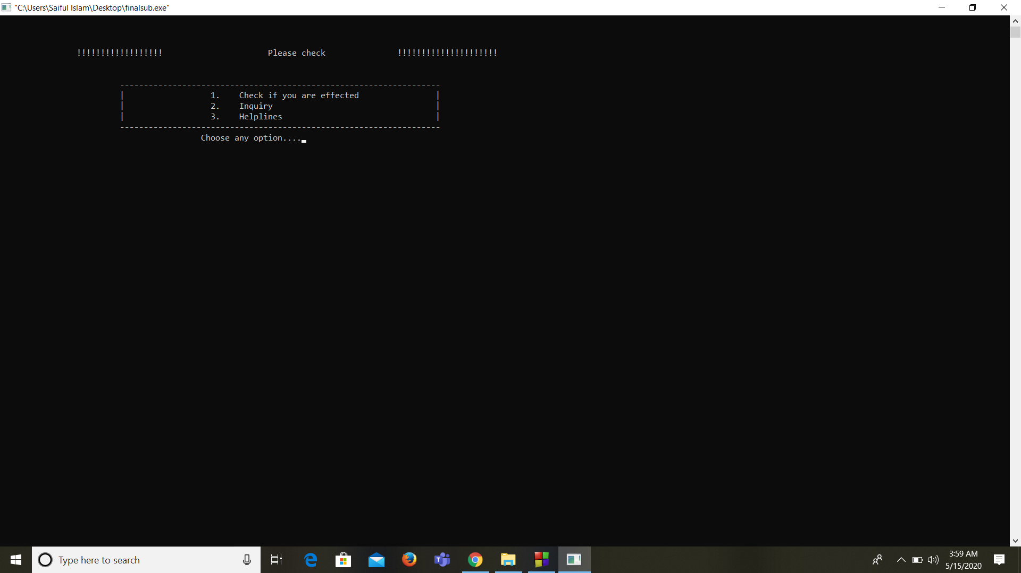

Slide 12
ADMIN MENU
ADMIN MOSTLY MODIFY THE PATIENT MENU
ADMIN CAN ADD NEW PATIENT FILE
ADMIN CAN ACCESS ALL PATIENT LIST
ADMIN CAN CLOSE ANY PATIENT FILE
ADMIN CAN MODIFY ANY PATIENT FILE

Slide 13
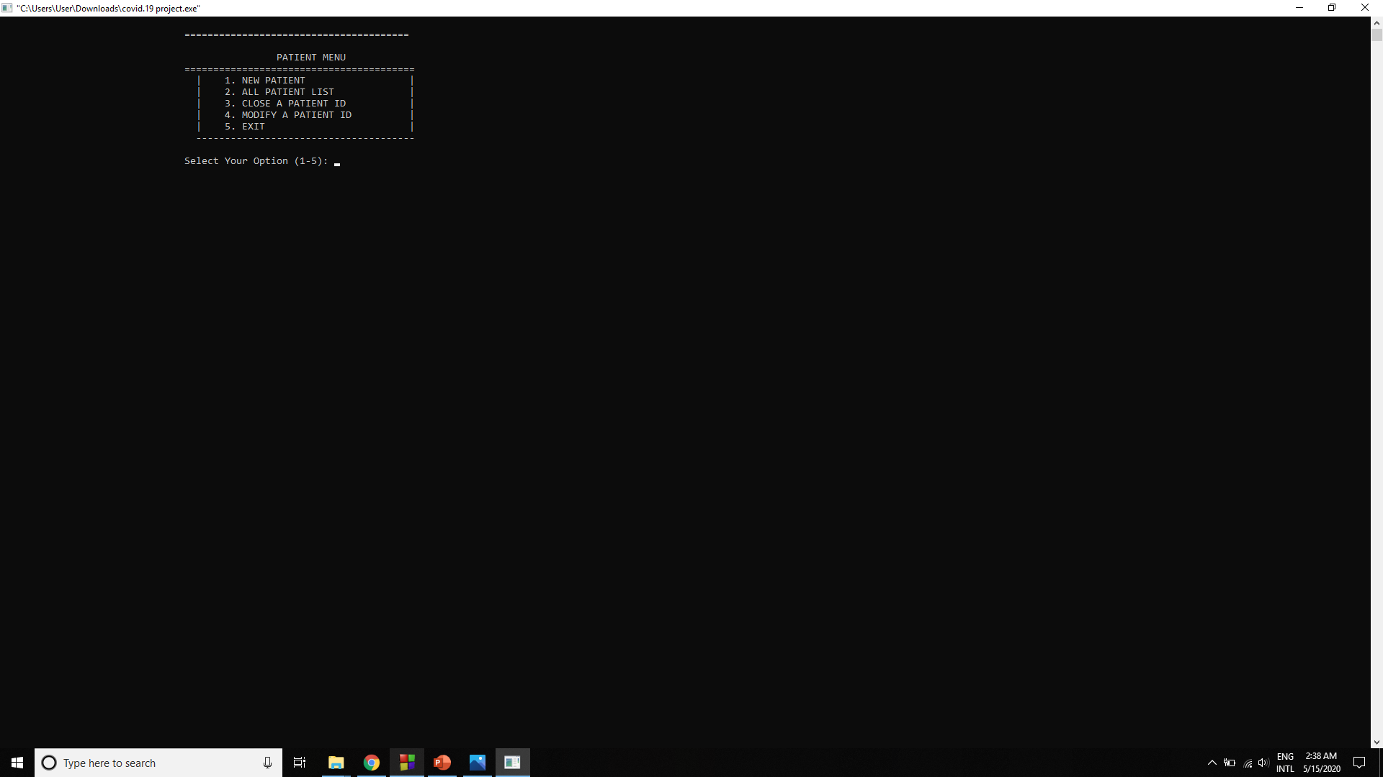

Slide 14
CONCLUSION
THIS PROJECT CAN ONLY DETECT YOUR SYMPTOMS.
SO IF U FIND MORE THAN 2 SYMPTOMS GO TO CHECK
IN A HOSPITAL AS SOON AS POSSIBLE.
IN OUR SICK RELIGIOUS SOCITY, COVID KNOWN AS NON
BELIEVER VIRUS OR KUFRI VIRUS OR FOREIGN VIRUS.
FOR THAT MANY OF US AFRAID TO CHECK THE VIRUS.
IT IS NOT JUST YOUR LIFE, THINK OF YOUR FAMILY.

Slide 15


